Slide 1
Unit- 1 Attitude Reconstruction
By: Sachin Sidhra

Slide 2
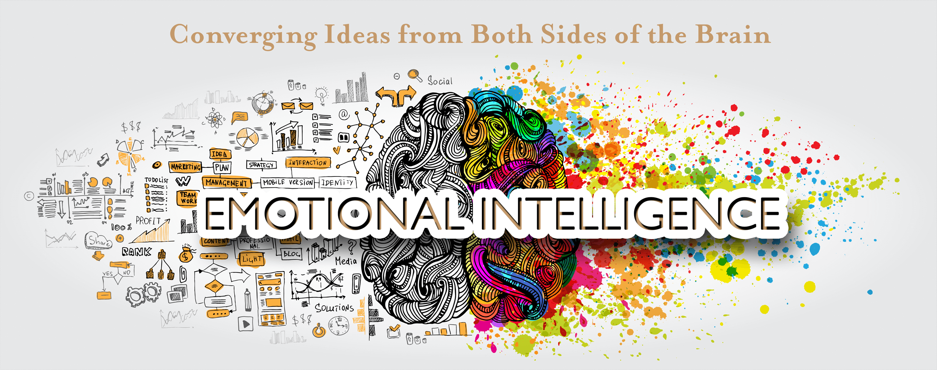
Understanding Emotional Intelligence

Slide 3
Emotional Intelligence is:
As defined by Daniel Goleman:
Emotional intelligence is the ability to perceive emotions, to access and generate emotions so as to assist thought
To understand emotions and emotional knowledge, and to reflectively regulate emotions so as to promote emotional and intellectual growth
In simple terms:
Emotional intelligence (otherwise known as emotional quotient or EQ) is the ability to understand, use, and manage your own emotions in positive ways to relieve stress, communicate effectively, empathize with others, overcome challenges and defuse conflict

Slide 4
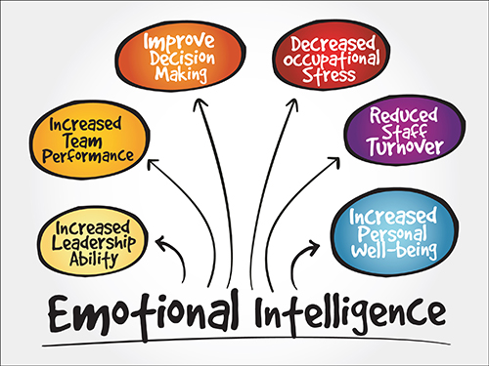
How does it help at work place?

Slide 5
Articles for reading:
http://www.emotionalintelligenceatwork.com/resources/attitude/
http://www.emotionalintelligenceatwork.com/resources/behaviour-cycle/
https://www.laughteronlineuniversity.com/feelings-and-emotions/

Slide 6


